Slide 1
Simple Algorithms
By Anirudh K M
Analyst, Mobius Knowledge Services

Slide 2
Guess and check algorithms
Guess and check is one of the most lucid algorithms to understand.
The idea is simple: Guess a value and check it by substitution method.
If true → that’s good.
If False → repeat with another value from a range.
Lets look at an example to understand.

Slide 3
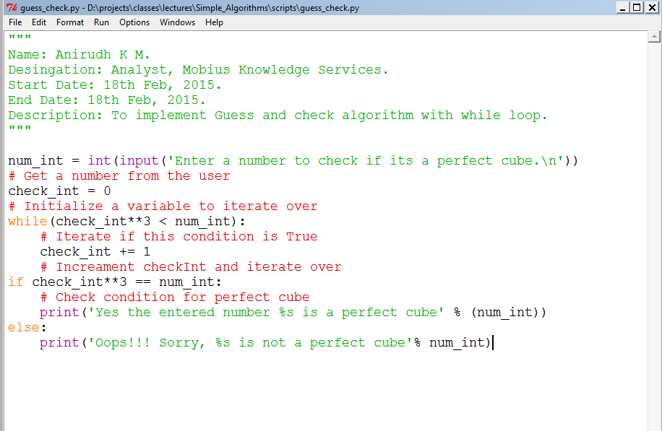
Illustration

Slide 4
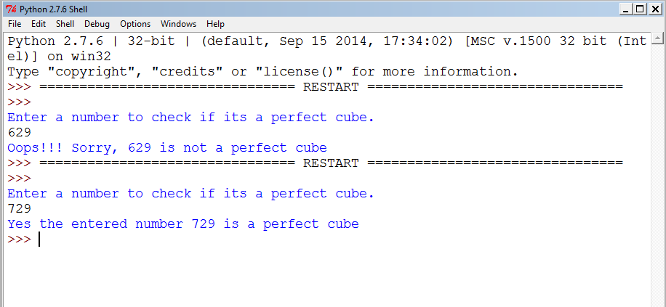
Output

Slide 5
Binary search
Bisection search is one of the optimum search method.
Now let us look at an example of how to find the square root of a number.

Slide 6
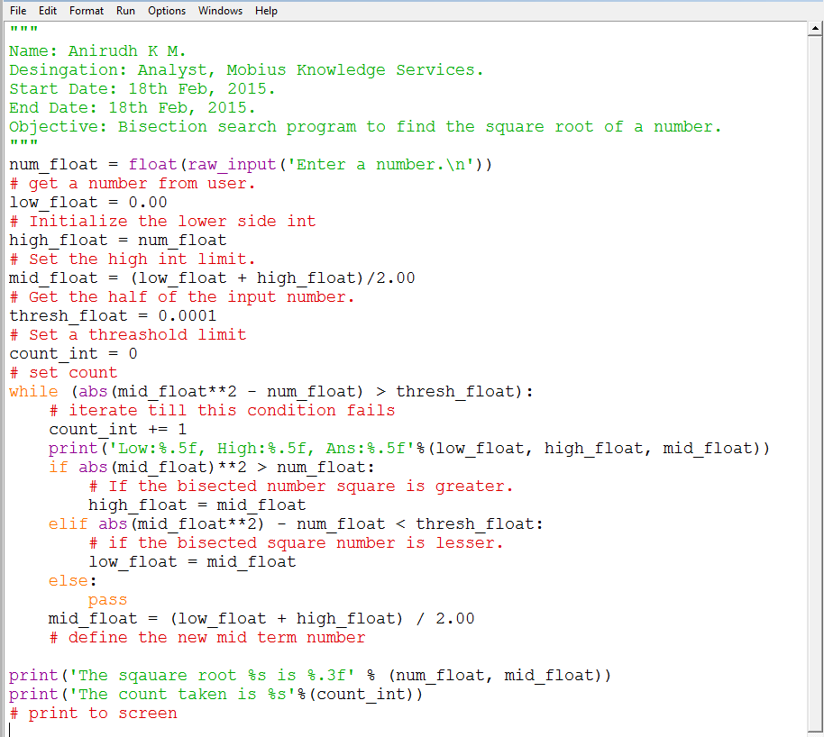
Illustration

Slide 7
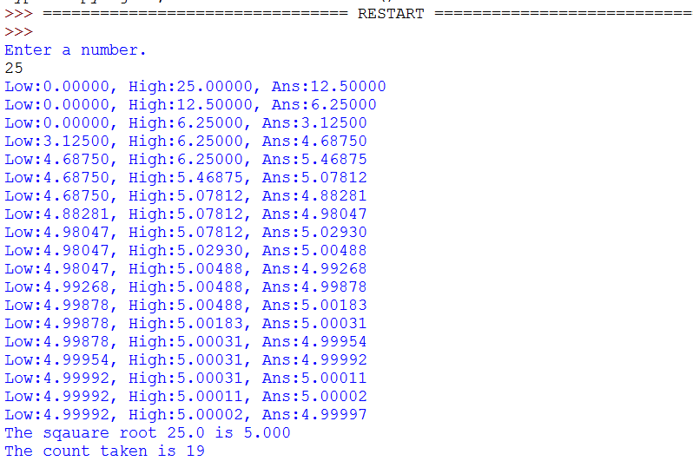
Output

Slide 8
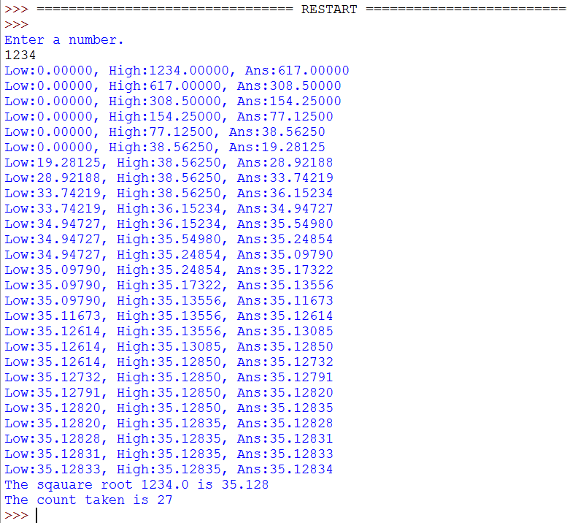
Output

Slide 9
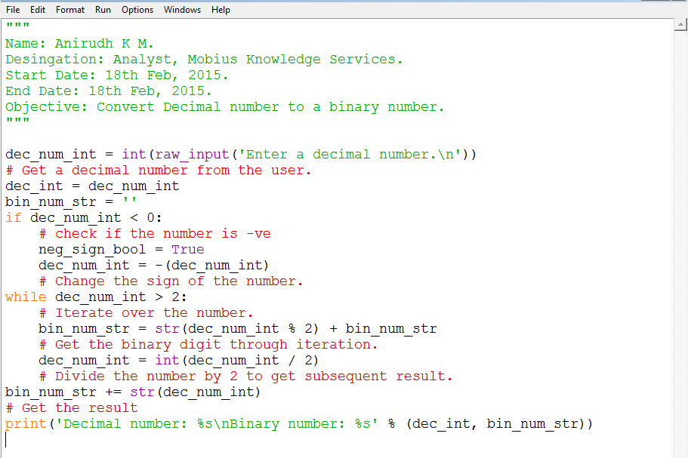
Decimal to Binary

Slide 10
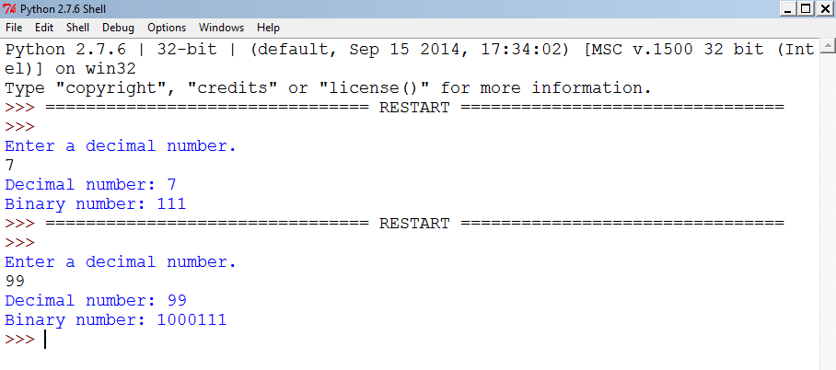
Output

